Slide 1
Project Title
UE20CS302 – Machine Intelligence
Mini Project
Project Title: Train AI to Play Game
Team No: 3
Project Guide : Dr. Pooja Agarwal
Project Team with SRNs :
Arunvenkat C A | PES2UG20CS068
Ashutosh Routray | PES2UG20CS072
C V Eswar sai Reddy | PES2UG20CS096

Slide 2
Problem Statement
The most common choice of implementation of difficulty in Al does not modify the way it thinks, but it rather changes variables in its actions, eg: reduced or increased precision and/or reaction time. This kind of implementation is transparent and does not help human players to feel the reality of the opposing or assisting units in a game
The players are rarely convinced that the Al is actually intelligent, with the belief that the computer-controlled units only work due to the fact that they have a cheating advantage by having access to otherwise hidden information within the game Al could be extremely expensive in terms of processing cycles and memory, so naturally in games the goal is not to recreate the human brain, but instead to mimic specific human behaviors with as little performance impact as possible
Notes:
Provide a basic introduction of the project and also an overview of scope it entails.
Set the context.

Slide 3
Application and Uses
Games are intended to provide entertainment and should be more interactive. For this reason NPC Characters can be trained
Testing games is a big task and involves many members. Using pre-trained games will be helpful to test the game after mutation of game.
Mimics Humans in games and takes unpredictable steps, which gives tough competition to users playing the game and makes game environment more competitive, fun and entertaining
Can be used for game parameter tuning, predicting level difficulty and average player pass rate
Games are perfect testbeds for AI model
Notes:
Provide a basic introduction of the project and also an overview of scope it entails.
Set the context.

Slide 4
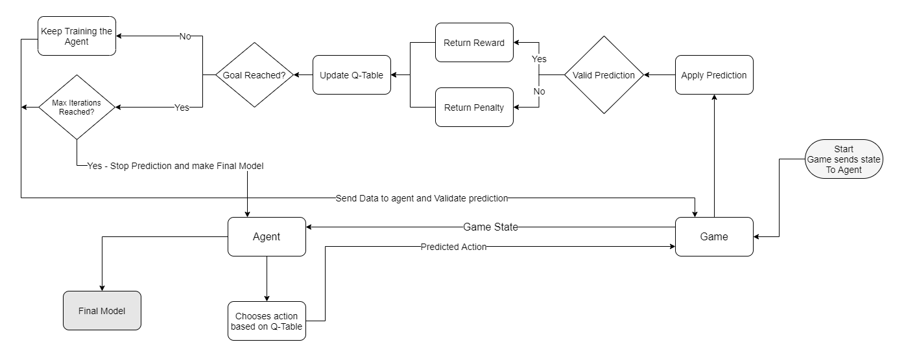
High level Architecture
Notes:
Provide a basic introduction of the project and also an overview of scope it entails.
Set the context.

Slide 5
Literature Survey
Title of the paper | Year of Publication | Journal/Conference Name | Advantages | Limitations
Creating Pro-Level AI for a Real-Time Fighting Game Using Deep Reinforcement Learning | 06 January 2021 | IEEE Transactions on Games ( Volume: 14, Issue: 2, June 2022) | This paper proposed methods to guide the fighting style with reward shaping which learns till the rewards hit the max point – which unlocks the possibility of Using AI to train NPC Characters in 3D games. | Disability of basic AI to compete evenly with professional players in a 3D fighting game.
Machine Learning Applied to Software Testing: A Systematic Mapping Study | 10 February 2019 | IEEE Transactions on Reliability ( Volume: 68, Issue: 3, September 2019) | The paper briefs about usage machine learning algorithms in software testing, which gives overall idea on use cases of AI in software testing and | It is difficult to make the model match the actual user’s behavior, which is not an easy task and lots of R&D is necessary for making the testing better.
Predicting Game Difficulty and Churn Without Players | November 2020 | CHI PLAY '20: Proceedings of the Annual Symposium on Computer-Human Interaction in Play | The paper showcases how RL can be used to simulate individual player differences without requiring retaining the agents or collecting new gameplay data for each simulated player. | Real-Life validation of model is not done so the model is not tested on real games which
Notes:
Provide summary of Phase – 1.
Include the suggestions and improvements made.

Slide 6
Literature Survey
Title of the paper | Year of Publication | Journal/Conference Name | Advantages | Limitations
Deep Reinforcement Learning for General Video Game AI | 14 October 2018 | 2018 IEEE Conference on Computational Intelligence and Games (CIG) | Usage of OpenAI gym environment in various AI (reinforcement learning) models such as Deep Q-network, Prioritized dueling DQN. Usage of required model, given analysis of various others. | The games are not very familiar as they are in Atari and therefore might lack some of the intuition. Another drawback is speed. The engine is written in Java and communicating through a local port to Python.
Enhancing the Monte Carlo Tree Search Algorithm for Video Game Testing | 24-27 August 2020 | 2020 IEEE Conference on Games (CoG) | Analysis of bug finding performance and success in different computational budgets gives us a better understanding of resources to be allocated. | Usage of this analysis method is limited to a few general video games and the type of agents used.
Augmenting Automated Game Testing with Deep Reinforcement Learning | 20 October 2020 | 2020 IEEE Conference on Games (CoG) | Gives us the fundamentals and mechanics of reinforcement learning models, that is agent controllers, agent observation, reward function, environments, test scenarios and training. | Games with higher difficulty level take a lot of time for the agent to master similar to the amount of time a human would take to play the same. Thus evaluation is computational heavy and time consuming.
Notes:
Provide summary of Phase – 1.
Include the suggestions and improvements made.

Slide 7
Literature Survey
Title of the paper | Year of Publication | Journal/Conference Name | Advantages | Limitations
A Survey of Video Game Testing | 20-21 May 2021 | 2021 IEEE/ACM International Conference on Automation of Software Test (AST) | Helps finds bugs problems of various kinds. Quality of a game is essential for it's success. | NO DISADVANTAGES
Human-Like Playtesting with Deep Learning | August 2018 | 2018 IEEE Conference on Computational Intelligence and Games (CIG) | supervised learning on a Convolutional Neural Network, Creates a metric of interest doesn’t follow MCTS but is used with a higher success rate with the predicted movements | There are many games which don’t have a guaranteed optimal play and can't be predicted with supervised learning
Reinforcement Learning in First Person Shooter Games | April 2011 | IEEE Transactions on Computational Intelligence and AI in Games 3(1):43 - 56 | Amazing success for classic style games(RL implemented). Used Algorithm is SARSA, slightly different from Q learning , Navigation, Item collection, combat Managed to beat a bot faster than standard A* | Doesn’t guarantee 100% success when compared to A*
Notes:
Provide summary of Phase – 1.
Include the suggestions and improvements made.

Slide 8
Proposed Approach
We use Reinforcement Learning with an approach as in the Markov Decision Process. This involves the possible states in the game, goal state, reward function and the different models/transitions.
Using models such as Q-Learning algorithm optimizes the output (action) to a specific input (state) trying to maximize the expected reward, which makes predictions better over time, using the concept of quality of action to each state. The potential reward is a weighted sum of expected values of the rewards of all future steps from current state to goal state. This way the AI model gets better at playing the game.
Notes:
Provide summary of Phase – 1.
Include the suggestions and improvements made.

Slide 9
Thank You

